Slide 1




BITS Pilani
Pilani Campus
BITS Pilani
Pilani Campus
(some slides adapted from http://aima.cs.berkeley.edu/)
DSE CL 557 - Artificial and Computational Intelligence
#1. Introduction
Saturday, August 29, 2020
1

Slide 2
Objectives of the course
BITS Pilani
Pilani Campus
To provide solid foundation for designing intelligent agents
Learn the representation and use of knowledge in inference-based problem solving approaches.
Learn to apply probability theory to describe and model agents operating in uncertain environments.
Learn the optimization models of computation and processing in real world application of intelligent agents
2

Slide 3
BOOKS
BITS Pilani
Pilani Campus
Text Book(s)
T1 Stuart Russell and Peter Norvig, “Artificial Intelligence – A Modern
Approach”, Third Ed, Pearson Education, 2010
Reference Book(s) & other resources
R1 Ryszard S. Michalski, Jaime G. Carbonell and Tom M. Mitchell,
“Machine Learning: An Artificial Intelligence Approach”, Elsevier, 2014
R2 Dan W Patterson, “Introduction to AI and Expert Systems”, Prentice Hall
of India, New Delhi, 2010
R3 Elaine Rich and Kevin Knight, “Artificial Intelligence”, Tata McGraw Hill
Publishing Company, New Delhi, 2003
3

Slide 4
Evaluation Components
BITS Pilani
Pilani Campus
Evaluation :
25% Assignment
5% Quiz
30% Mid Semester
40% End Semester
4

Slide 5
Agenda
BITS Pilani
Pilani Campus
What is Artificial Intelligence?
Acting Humanly
Thinking Humanly,
Thinking Rationally,
Acting Rationally
Foundations of AI (3)Brief History of AI
(4) Brief Overview of Modern AI & Application Domains.
5

Slide 6
Definition of Intelligence
BITS Pilani
Pilani Campus
Dictionary.com : capacity for learning, reasoning, understanding and similar forms of mental activity
Ability to perceive and act
Reasoning, proving theorems
Planning: take decisions
Learning and Adaptation
Understanding: text, speech and visual scene
6

Slide 7
Definition of AI
BITS Pilani
Pilani Campus
Artificial Intelligence is concerned with making artificial device intelligent.
The term was coined by McCarthy in 1956.
There are two concepts in the definition: Intelligence and Artificial device

Slide 8
Different Types of Artificial Intelligence
BITS Pilani
Pilani Campus
Systems that think like human
Systems that act like human
Systems that think rationally
Systems that act rationally
Last type is adopted by Modern AI

Slide 9
Thinking Humanly
BITS Pilani
Pilani Campus
Cognitive Modelling Approach
Some Definitions of AI
“The exciting new effort to make computers think . . . machines
with minds, in the full and literal sense.” (Haugeland, 1985)
“[The automation of] activities that we associate with human thinking, activities such as decision-making, problem solv- ing, learning . . .” (Bellman, 1978)

Slide 10
Thinking Humanly
BITS Pilani
Pilani Campus
Cognitive Modelling Approach
How do we capture human thinking to implement
Introspection
Psychological Experiments
Brain Imaging
System : “General Problem Solver” (Newell and Simon, 1961)
Designed to work as a universal problem solver
Problems represented by horn clauses
First AI Machine which has KB + Inference separation
Authors focus on this is on comparing the trace of its reasoning steps to traces of human subjects solving the same problems
Growth of Cognitive science and AI supports each other

Slide 11
Acting Humanly
BITS Pilani
Pilani Campus
Turing Test Approach
Some Definitions of AI:
“The art of creating machines that perform functions that require
intelligence when performed by people.” (Kurzweil, 1990)
“The study of how to make computers do things at which, at the moment, people are better.” (Rich and Knight, 1991)

Slide 12
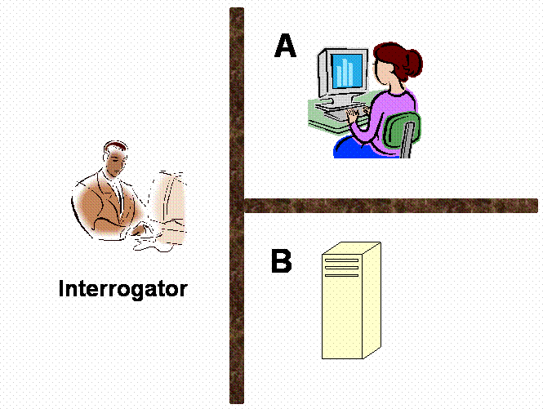
Act like Human: Turing Test
BITS Pilani
Pilani Campus
There are two rooms, A and B.
One of the rooms has a computer and the other contains a human.
The interrogator is outside and does not know which one is a computer.
He asks questions through a teletype and
receives answers from both A and B rooms.
The interrogator needs to identify whether A or B are humans.
To pass the Turing test, the machine has to fool the interrogator into believing that it is human.

Slide 13
Thinking Rationally
BITS Pilani
Pilani Campus
“Laws of Thought” Approach
Invention of Formal Logic, Greek Philosopher Aristotle, Third century BC.
Introduced syllogisms, providing argument structures
In all boring classes, students sleeps

Slide 14
Thinking Rationally
BITS Pilani
Pilani Campus
“Laws of Thought” Approach
Invention of Formal Logic, Greek Philosopher Aristotle, Third century BC.
Introduced syllogisms, providing argument structures
In all boring classes, students sleeps
It is a boring class

Slide 15
Thinking Rationally
BITS Pilani
Pilani Campus
“Laws of Thought” Approach
Invention of Formal Logic, Greek Philosopher Aristotle, Third century BC.
Introduced syllogisms, providing argument structures
In all boring classes, students sleeps
It is a boring class
Students sleeps in this class [ Are you ? ]

Slide 16
Thinking Rationally
BITS Pilani
Pilani Campus
“Laws of Thought” Approach
Invention of Formal Logic, Greek Philosopher Aristotle, Third century BC.
Introduced syllogisms, providing argument structures
In all boring classes, students sleep
It is a boring class
Students sleep in this class [ Are you ? ]
Field of Logics gave rise to codifying rational thinking
When elements are ‘things’, we reason about things
Hurdles to the idea : (1) Not everything can be logically coded (2) no provably correct action at a moment (3) Exhaustive computational resources

Slide 17
Acting Rationally
BITS Pilani
Pilani Campus
The Rational Agent Approach
An agent is an entity that perceives and acts
This course is about designing rational agents
Abstractly, an agent is a function from percept histories to actions:
[f: P* → A]
For any given class of environments and tasks, we seek the agent (or class of agents) with the best performance
Computational limitations make perfect rationality unachievable
Design best program for given machine resources

Slide 18
Acting Rationally
BITS Pilani
Pilani Campus
The Rational Agent Approach
Rational behavior: doing the right thing
The right thing: that which is expected to maximize goal achievement, given the available information
Rational behaviour is not just about correct inference / thinking, skills needed to pass turing test etc.
(adv) : More General - Correct inference is just a thing
(adv) : More amenable for scientific developments, as the rational behaviour is better defined than human thinking and behavior

Slide 19
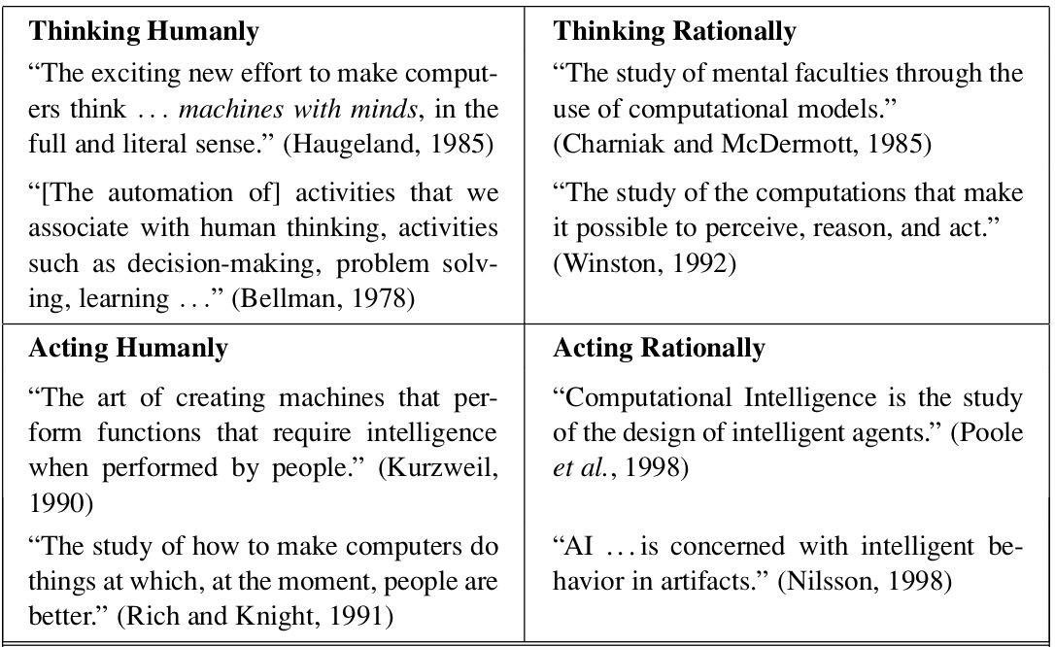
Definitions
BITS Pilani
Pilani Campus

Slide 20
About the course
BITS Pilani
Pilani Campus
Course focuses on
principles of artificial intelligence
concepts, algorithms involved in building rational agents
topics covered like
(informed and uninformed ) search & applications
(logical & probabilistic ) knowledge representation
(logical & probabilistic ) Reasoning & applications
a bit of learning (reinforcement learning)
topics not-covered like
Formal introduction to machine learning algorithms, neural
networks etc are covered as a ML course is running in parallelly, Deep neural networks ( deep learning course) , which are part of AI as well.

Slide 21
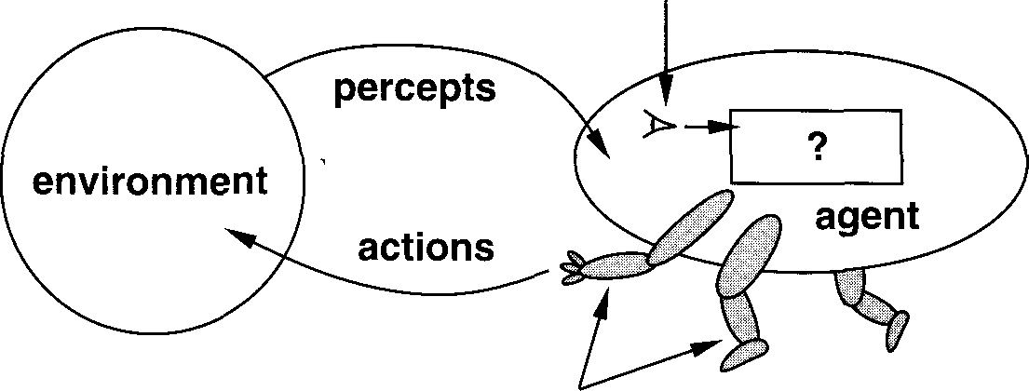
Intelligent Agents
BITS Pilani
Pilani Campus
effectors

Slide 22
Rational Agents
BITS Pilani
Pilani Campus
An agent should strive to do the right thing based on what it can perceive and the actions it can perform. The right action is the one that will cause the agent to be most successful.
Performance measure: An objective criterion for success
of an agent’s behavior
Eg. Performance measure of a vacuum-leaner agent could be the amount of dirt cleaned up, amount of time taken, amount of electricity consumed, amount of noise generated

Slide 23
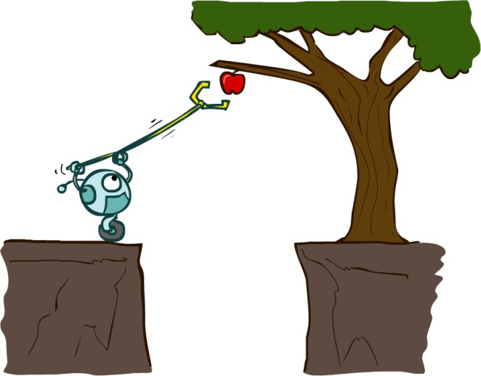
Designing Rational Agents
BITS Pilani
Pilani Campus
An agent is an entity that perceives and acts.
A rational agent selects actions that maximize its (expected) utility.
Characteristics of the percepts, environment, and action space dictate techniques for selecting rational actions
This course is about:
General AI techniques for a variety of problem types
Learning to recognize when and how a new problem can be solved with an existing technique
Sensors
Environment
Agent
Percepts
?
Actuators
Actions

Slide 24
TYPICAL AI PROBLEMS
BITS Pilani
Pilani Campus
Intelligent entities should be able to do both mundane and expert tasks.
Mundane tasks:
Planning route, activity
Recognizing people, objects
Communicating through natural language
Navigating round obstacles on the streets.
Expert tasks:
Medical diagnosis
Mathematical problem solving

Slide 25
What’s easy and what’s hard
BITS Pilani
Pilani Campus
The following requires skill development and/or intelligence and only some specialists can perform them well.
Symbolic integration
Proving theorems
Playing chess
Medical diagnosis
Computer systems have made an achievement in accomplishing these tasks.

Slide 26
What’s easier and what’s hard
BITS Pilani
Pilani Campus
Its very hard to make computer systems perform many routine tasks that all humans and a lot of animals can do
Walking around without running into things
Catching prey and avoiding predators
Interpreting complex sensory information
Modeling the internal states of animals from their behavior

Slide 27
Intelligent behavior
BITS Pilani
Pilani Campus
Perception
Reasoning
Learning
Understanding language
Solving problems

Slide 28
Applications
BITS Pilani
Pilani Campus
Computer Vision
Image recognition
Robotics
Natural Language Processing
Speech Processing

Slide 29
Practical Impact of AI
BITS Pilani
Pilani Campus
AI components are embedded in numerous devices. E.g. copy machine
AI systems are in everyday use
Detecting credit card fraud
Configuring products
Aiding complex planning task
Advising physician
Intelligent tutoring systems provide the students with personalized attention

Slide 30
Limits of AI Today
BITS Pilani
Pilani Campus
Today’s successful AI systems
operate in well-defined domains
employ narrow and specialized knowledge.
Common sense knowledge
Needed in complex and open-ended worlds.
understand unconstrained natural language.

Slide 31
What can AI systems do
BITS Pilani
Pilani Campus
Computer vision : face recognition
Robotics: autonomous vehicles.
Natural language processing: simple machine translation.
Expert systems: medical diagnosis
Speech understanding systems ~ 1000 words continuous speech
Learning: text categorization into ~ 1000 topics
In Games, AI systems can play at the Grand Master level in chess (world champion), checkers, etc.

Slide 32
What can AI systems NOT do yet?
BITS Pilani
Pilani Campus
Understand natural language robustly (e.g., read and understand articles in a newspaper)
Surf the web
Interpret an arbitrary visual scene
Learn a natural language
Construct plans in dynamic real-time domains
Exhibit true autonomy and intelligence

Slide 33
BITS Pilani
Pilani Campus
AI History
The dream of making computer imitate us began many centuries ago.
Aristotle (384-322 BC) developed an informal system of syllogistic logic, which is the basis of the first formal deductive reasoning system.
Early in the 17th century, Descartes proposed that bodies of animals are nothing more than complex machines.
Pascal in 1642 made the first mechanical digital calculating machine.
In the 19th century, George Boole developed a binary algebra representing (some) "laws of thought."
Charles Babbage & Ada Byron worked on programmable mechanical calculating machines.
In the late 19th century and early 20th century, mathematical philosophers like Gottlob Frege, Bertram Russell, Alfred North Whitehead, and Kurt Gödel built on
Boole's initial logic concepts to develop mathematical representations of logic problems.

Slide 34
AI History
BITS Pilani
Pilani Campus
The advent of electronic computers provided a revolutionary advance in the ability to study intelligence.
In 1950 Turing wrote an article on “Computing Machinery and Intelligence” which articulated a complete vision of AI.
Turing’s paper talked of many things, of solving problems by searching through the space of possible solutions, guided by heuristics. He illustrated his ideas on machine intelligence by reference to chess. He even propounded the possibility of letting the machine alter its own instructions so that machines can learn from experience.

Slide 35
AI History
BITS Pilani
Pilani Campus
In 1956 a famous conference took place in Dartmouth. The conference brought together the founding fathers of artificial
intelligence for the first time. In this meeting the term “Artificial Intelligence” was adopted.

Slide 36
AI History
BITS Pilani
Pilani Campus
The 1990's saw major advances in all areas of AI including the following:
machine learning, data mining
intelligent tutoring,
case-based reasoning,
multi-agent planning, scheduling,
uncertain reasoning,
natural language understanding and translation,
vision, virtual reality, games, and other topics.

Slide 37
BITS Pilani
Pilani Campus
Modern AI
8/29/2020 7:42 PM
37

Slide 38


Deep Learning Breakthroughs (2012 –
Present)
BITS Pilani
Pilani Campus
In 2012, deep learning beats
the
previous benchmark on
ImageNet competition.
In 2013, deep learning is used to understand
“conceptual meaning” of words.
In 2014, similar breakthroughs appeared in language translation.
These have led to advancements in Web Search, Document Search, Document
“Hello”
“你好”
Google Translate
Summarization, and Machin_{*Ot} e_{er}
Tm rs and nbransds lmaay te icloaimend as.

Slide 39
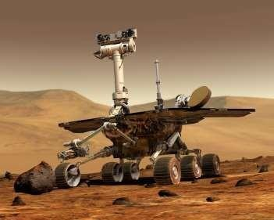
Deep Learning Breakthroughs (2012 – Presen^{B}t)^{ITS Pilani}
Pilani Campus
In 2014, computer vision algorithm can describe photos.
In 2015, Deep learning platform TensorFlow* is developed.

Slide 40
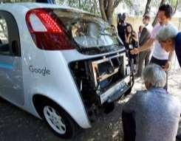


Modern AI (2012 – Present): Deep Learning Im^{BI}p^{TS}ac^{P}t^{ilani}
Pilani Campus
Computer vision
Natural language
Self-driving cars: object detection
Healthcare:
improved diagnosis
Communication: language translation

Slide 41









BITS Pilani
Pilani Campus
How Is This Era of AI Different?
Faster Computers
Bigger Datasets
Neural Nets
Cutting Edge Results in a Variety of Fields

Slide 42
BITS Pilani
Pilani Campus
Other Modern AI Factors
Continued expansion of open source AI, especially in Python*, aiding machine learning and big data ecosystems.
Leading deep learning libraries open
by industry.
Open sourcing of large datasets of millions of labeled images, text datasets such as Wikipedia has also driven breakthroughs.
sourced, allowing further adoption

Slide 43
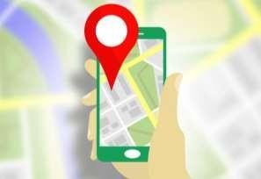
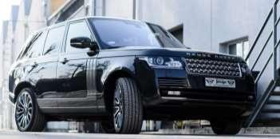
BITS Pilani
Pilani Campus
AI In Transportation
Navigation
Ride sharing
Uber & Lyft predict real-time demand using AI techniques, machine learning, deep learning.
Google & Waze find the fastest route, by processing traffic data.

Slide 44


BITS Pilani
Pilani Campus
AI In Social Media
Audience
Content
Facebook & Twitter use AI to decide what content to present in their feeds to different audiences.
Image recognition and sentiment analysis to ensure that content of the appropriate “mood” is being served.

Slide 45
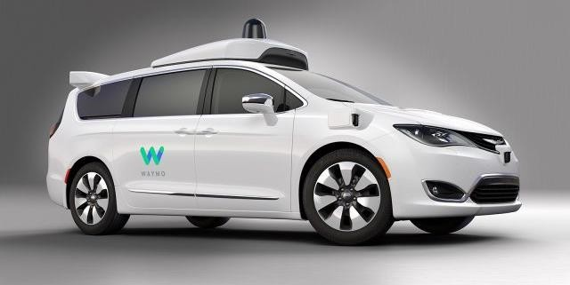
Autonomous cars
BITS Pilani
Pilani Campus

Slide 46
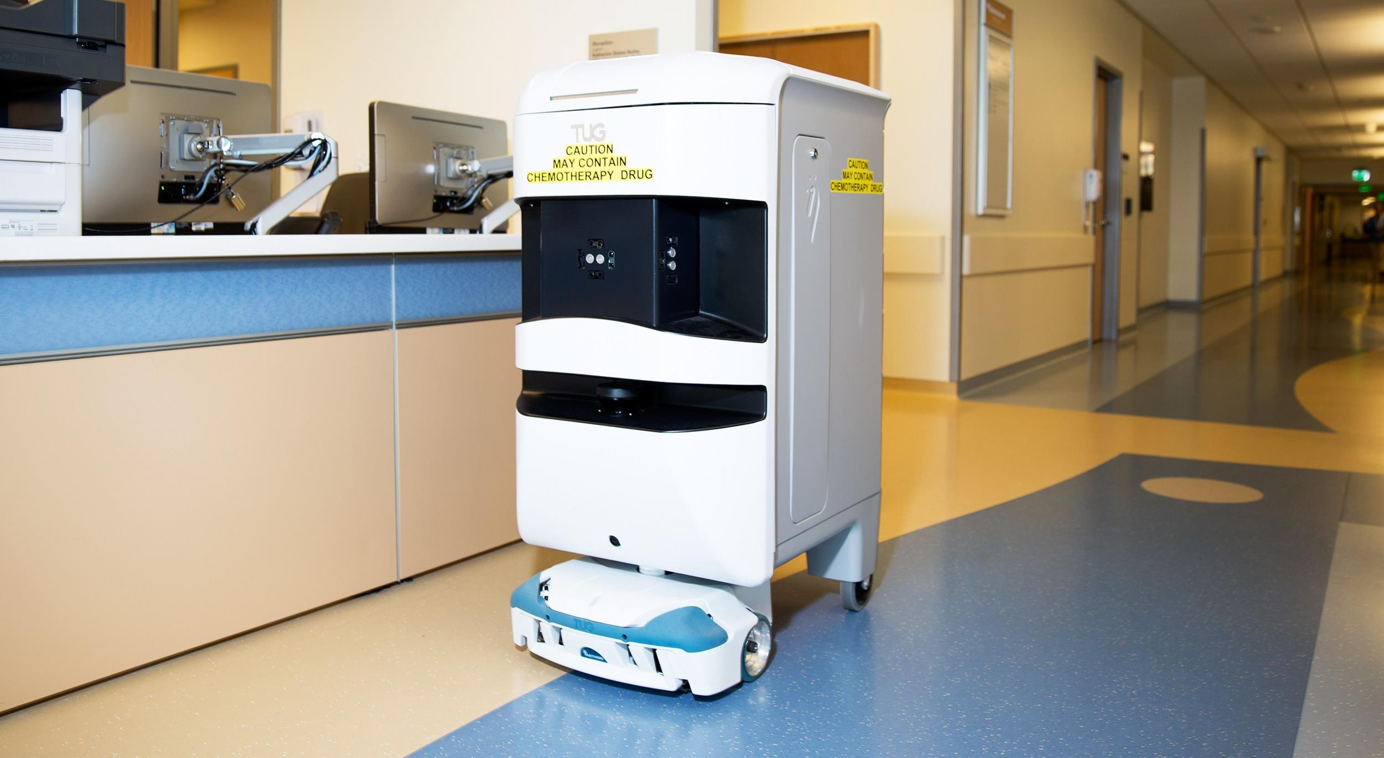
Robots help nurses in hospitals deliver stuff to different rooms
BITS Pilani
Pilani Campus

Slide 47
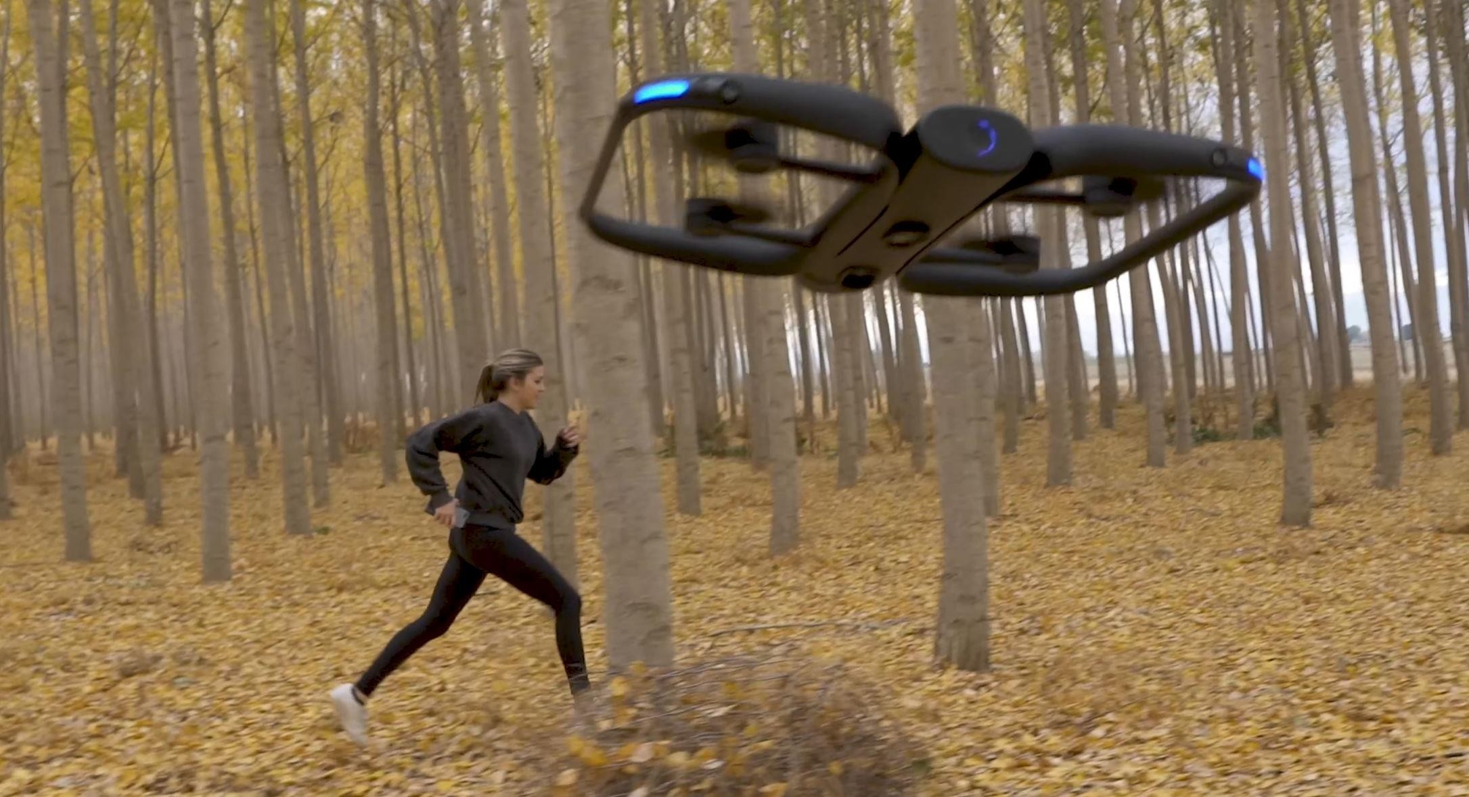
Drones that record cool videos
BITS Pilani
Pilani Campus

Slide 48
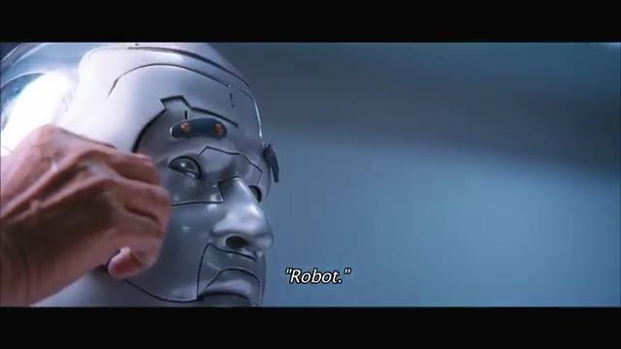
A Robot Learning on it’s own
BITS Pilani
Pilani Campus

Slide 49
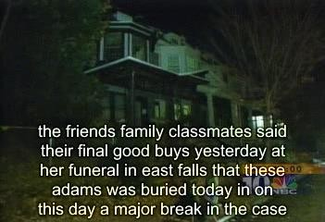


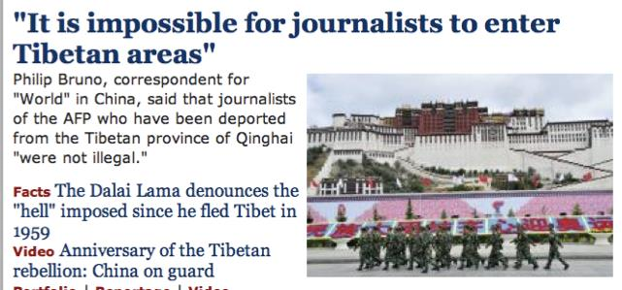
Natural Language
BITS Pilani
Pilani Campus
Speech technologies (e.g. Siri)
Automatic speech recognition (AS
Text-to-speech synthesis (TTS)
Dialog systems
Language processing technologi
Question answering
Machine translation
R)
es
Web search
Text classification, spam filtering, etc…
https://play.aidungeon.io/

Slide 50
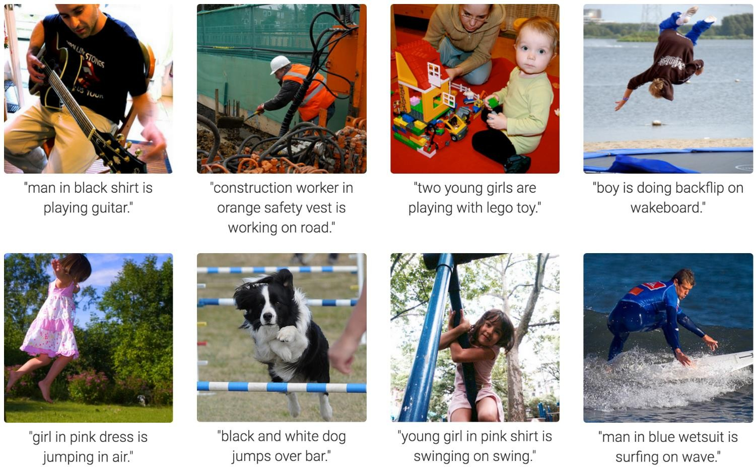
Computer Vision
BITS Pilani
Pilani Campus
Karpathy & Fei-Fei, 2015; Donahue et al., 2015; Xu et al, 2015; many more

Slide 51
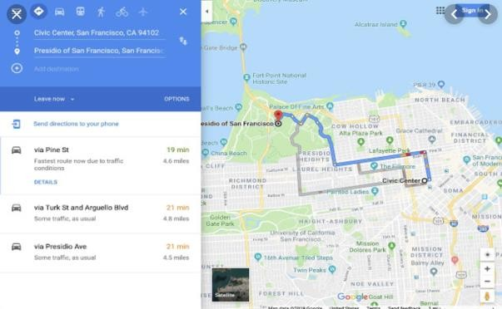
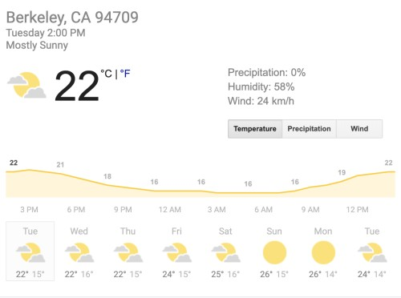




Tools for Predictions & Decisions
BITS Pilani
Pilani Campus

Slide 52
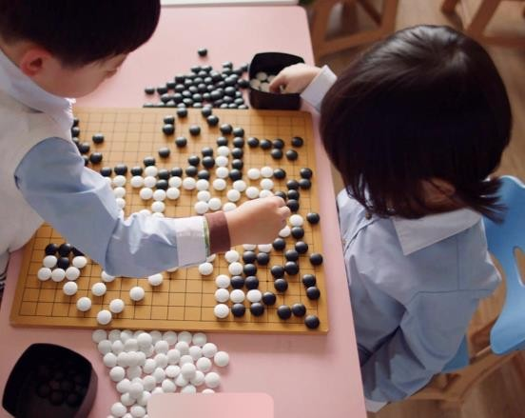
AlphaGo
BITS Pilani
Pilani Campus
AlphaGo is the first computer program to defeat a professional human Go player
Go originated in China over 3,000 years ago. Winning this board game requires multiple layers of strategic thinking.
At the opening move in Chess there are 20 possible moves. In Go the first
player has 361 possible moves
Policy network -selects the next move to play.
Value network predicts the game winner

Slide 53
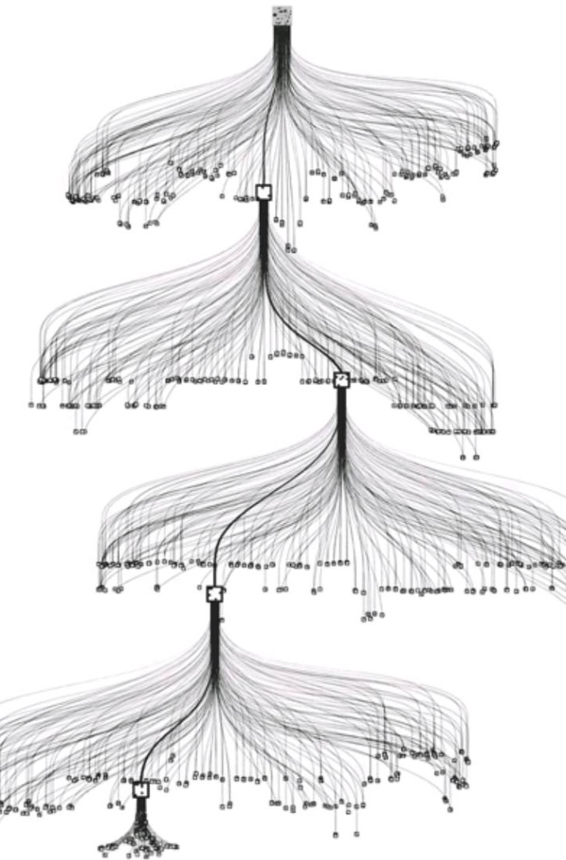
AlphaGo
BITS Pilani
Pilani Campus
AlphaGo must restrict Breath and Depth of search among all board configurations with heuristics information supplied by training and winning policy for max reward.

Slide 54
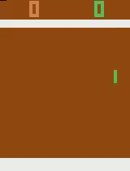
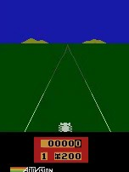
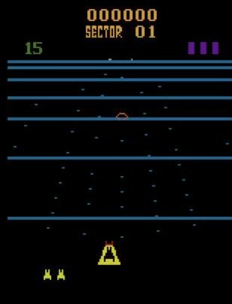
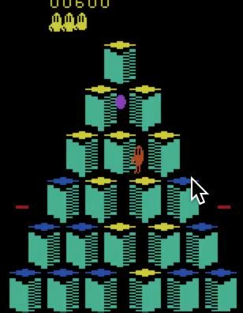
Game Agents
BITS Pilani
Pilani Campus
Reinforcement learning
Pong
Enduro
Beamrider
Q*bert

Slide 55
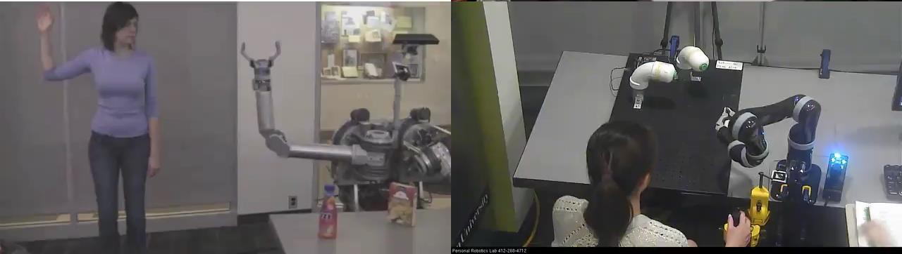
Human-AI Interaction
BITS Pilani
Pilani Campus

Slide 56
Areas Contributing to AI
BITS Pilani
Pilani Campus
Philosophy
Mathematics
Economics
Neuroscience
Psychology
Computer Engineering
Control theory, Cybernetics
Linguistics
How should we make decisions so as to maximize payoff?
Utility / preferred outcomes
Decision theory -Probability & utility theory
Game theory
How to make decisions when payoffs are not immediate?
MDP

Slide 57
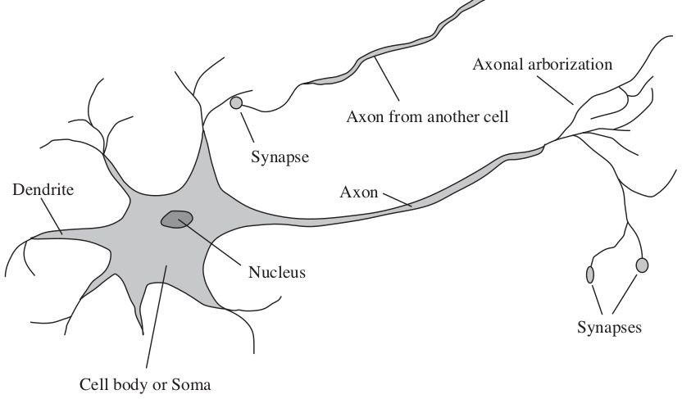
Areas Contributing to AI
BITS Pilani
Pilani Campus
Philosophy
Mathematics
Economics
Neuroscience
Psychology
Computer Engineering
Control theory, Cybernetics
Linguistics
How do brains process information?
Study of the nervous system / brain
How does brain enables thoughts - Mystery Still
Aristotle , “Of all the animals, man has the largest brain in proportion to his size”

Slide 58
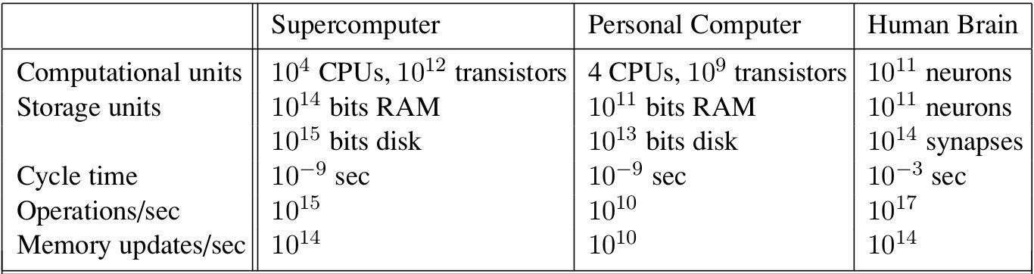
Areas Contributing to AI
BITS Pilani
Pilani Campus
Philosophy
Mathematics
Economics
Neuroscience
Psychology
Computer Engineering
Control theory, Cybernetics
Linguistics

Slide 59
Areas Contributing to AI
BITS Pilani
Pilani Campus
Philosophy
Mathematics
Economics
Neuroscience
Psychology
Computer Engineering
Control theory, Cybernetics
Linguistics
How do humans and animals think and act?
Cognitive Psychology - Brain as an information-processing device
Two months after the dartmouth workshop, a workshop in MIT gave birth to Cognitive Science
George Miller, Noam Chomsky, Allen Newell and Herbert Simon - roles of computer models to address the psychology of memory, language, and logical thinking, issues..
“a cognitive theory should be like a computer program” (Anderson, 1980);

Slide 60
Areas Contributing to AI
BITS Pilani
Pilani Campus
Philosophy
Mathematics
Economics
Neuroscience
Psychology
Computer Engineering
Control theory, Cybernetics
Linguistics
Computers & Programming Languages

Slide 61
Areas Contributing to AI
BITS Pilani
Pilani Campus
Philosophy
Mathematics
Economics
Neuroscience
Psychology
Computer Engineering
Control theory, Cybernetics
Linguistics
Control theory
Deals with the behaviour of dynamic systems
behaviour must ensure the error between the current state and goal state is minimized
Cybernetics - Book by Wiener
(Norbert Wiener, 1948) : Scientific study of control and communication in the animal and the machine
Ashby’s Design for a Brain (1948, 1952):
Intelligence could be created by the use of homeostatic devices containing appropriate feedback loops to achieve stable adaptive behavior
Led to the idea of design of systems that maximize an objective function over time

Slide 62
Areas Contributing to AI
BITS Pilani
Pilani Campus
Philosophy
Mathematics
Economics
Neuroscience
Psychology
Computer Engineering
Control theory, Cybernetics
Linguistics
How does language relate to thought? Verbal Behavior (1957, B. F. Skinner) :
Behaviorist approach to language learning
Reviewed by Noam Chomsky
criticised lack of notion of creativity in language
Syntactic Structures ( 1957, Noam Chomsky)
Computational linguistics / natural language processing as a part of AI
Understanding a language is realized as more complex than ever
Context, subject matter knowledge
complicated it further
Representing language consumed volume of work done in NLP, in early t

Slide 63
Thank You
BITS Pilani
Pilani Campus
Required Reading:
AIMA - Chapter # 1.1
AIMA - Chapter # 1.2 - Must Read & Google a lot
Note : Some of the slides are adopted from AIMATB materials

Slide 64
DSE CL557 - Artificial & Computational Intelligence #2 : Rational Agents and Environments
Dr Jyotsana Grover
WILP

Slide 65
Learning Objectives
After this session, you will be able to :
Understand the concept of artificial intelligent agent
Understand the basic concept of rationality
Interpret and apply fundamental of type of agent on current problems
related to artificial intelligence.

Slide 66
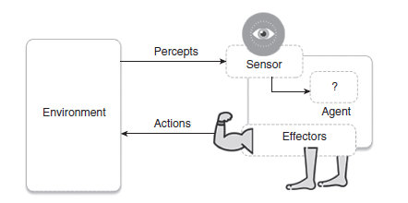
Agents
An agent is anything that can be viewed as perceiving its environment through sensors and acting upon that environment through actuators

Slide 67
Agents
The complete set of inputs at a given time is called a percept.
The current percept, or a sequence of percepts can influence the actions of an agent.
The agent can change the environment through actuators or effectors.
An operation involving an effector is called an action.
The agent can have goals which it tries to achieve.
Thus, an agent can be looked upon as a system that implements a mapping from
percept sequences to actions.

Slide 68
Agent Performance
An agent function implements a mapping from perception history to action.
The performance of intelligent agents have to be evaluated in terms of the agent function.
The ideal mapping specifies which actions an agent ought to take at any point in
time.
The performance measure is a subjective measure to characterize how successful an
agent is.
The success can be measured in various ways.
It can be measured in terms of speed or efficiency of the agent or the accuracy or the
quality of the solutions achieved by the agent.

Slide 69
Examples
Humans can be looked upon as agents. They have eyes, ears, skin, taste buds, etc. for sensors; and hands, fingers, legs, mouth for effectors.
Robots are agents. Robots may have camera, sonar, infrared, bumper, etc. for
sensors. They can have grippers, wheels, lights, speakers, etc. for actuators. Some examples of robots are Xavier from CMU.
Expert Systems: Cardiologist
Intelligent buildings

Slide 70
Agent Faculties
The fundamental faculties of intelligence are
Acting
Sensing
Understanding, reasoning, learning

Slide 71
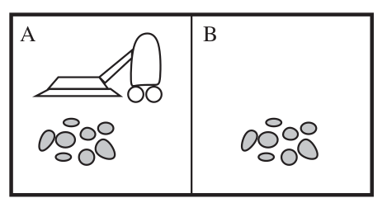
A simple agent: Vacuum cleaner
Simple vacuum cleaner agent
The vacuum agent perceives in which square it is in and if there is dirt in the square. It may choose to move left, right or suck up the dirt or do nothing. On the basis of the aforementioned task, one of the very simple functions of the agent is the following: If the current square is dirty then suck, otherwise move to other square. Hence, we can write:
Precepts: location and status, e.g., [A, Dirty]
Actions: left, right, suck and no-op (Do Nothing)

Slide 72
Vacuum cleaner problem
Performance measure of vacuum cleaner agent: All the rooms are well cleaned.
Behaviour/action of agent: Left, right, suck and no-op (Doing nothing).
Percept: Location and status, for example, [A, Dirty].
Agent function: Mapping of precept sequence to an action

Slide 73
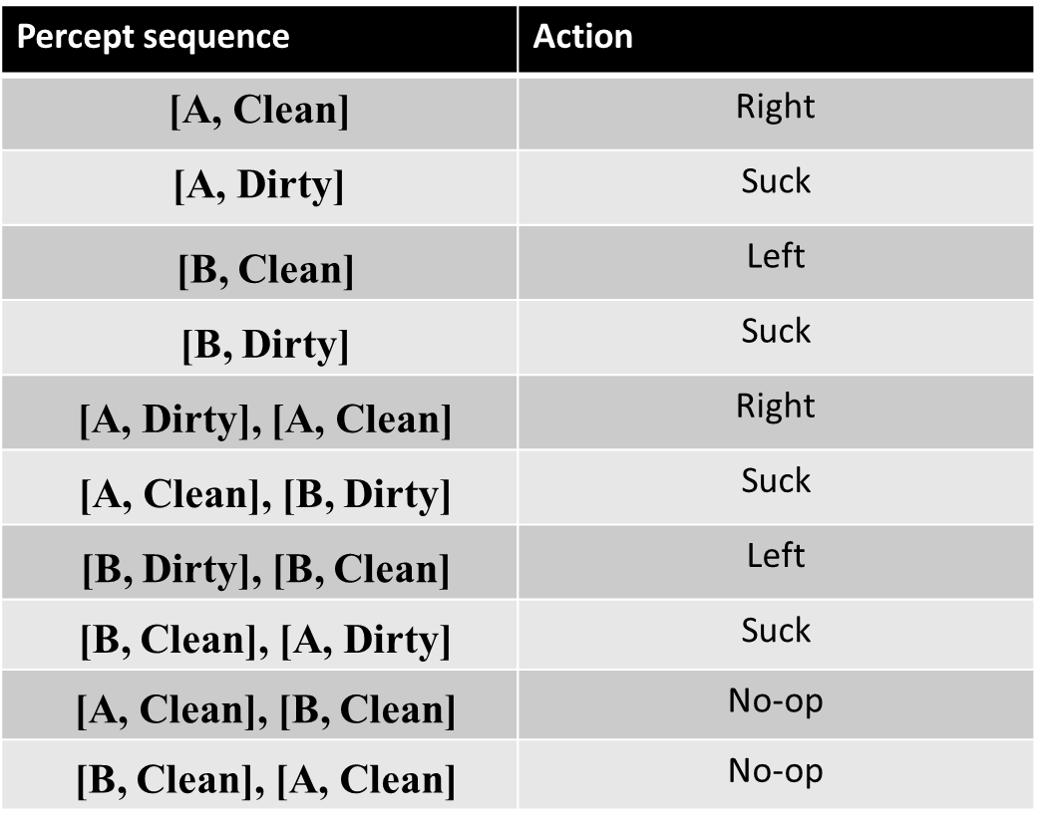
Vacuum cleaner problem

Slide 74
Intelligent Agents
An Intelligent Agent must sense, must act, must be autonomous (to some extent). It also must be rational (ideal).
AI is about building rational agents. An agent is something that perceives and acts. A rational agent always does the right thing.
While designing the intelligent systems, there are following four main factors to be
considered
P, Percepts: The inputs to the AI system.
A, Actions: The outputs of the AI system.
G, Goals: What the agent is expected to achieve.
E, Environment: What the agent is interacting with one.

Slide 75
Examples
Agent type | Percepts | Actions | Goals | Environment
Medical diagnostic system | Symptoms, test results, patient’s answers | Questions, test requests, treatments, referrals | Healthy patients, minimise the costs | Patient, hospital, staff
Satellite image analysis system | Pixels of varying intensity and colour | Display a categorisation of the scene | Correct image categorisation | Images from orbiting satellite
Part-picking robot | Pixels of varying intensity and colour | Pick up parts and sort them into bins | Place parts into correct bins | Conveyor belt with parts, bins
Refinery controller | Temperature, pressure and chemical readings | Open and close valves, adjust temperature | Maximise purity, yield, safety | Refinery, staff
Interactive | Typed words | Display exercises, | Maximise Result of students | Set of students,

Slide 76
Rationality
We want our agents to be Rational – that is, we want them to do the “right
thing”
What is the “right thing”? Performance measure Condition or state of the world
we want to achieve
Vacuum cleaner world: “Both rooms are clean”
could have additional criteria – minimize time or power consumption

Slide 77
Defining Rational Agent
A rational agent tries to maximize its performance measure, given percepts and actions.
For each possible percept sequence, a rational agent should select an action that is expected to maximize its performance measure, given the evidence provided by the percept sequence and whatever built-in knowledge the agent has

Slide 78
Omniscience vs. Rationality
An omniscient (perfect) agent knows the actual outcome of its actions and can act accordingly; but perfection is impossible in reality.
• Rationality is NOT the same as perfection.
• Rationality maximizes expected performance, while perfection maximizes actual performance.
• A rational agent not only to gather information (exploration) but also to learn as much as possible from what it perceives.
• An agent relies on the prior knowledge of its designer rather than on its own percepts, we say that the agent lacks autonomy.
A rational agent should be autonomous. •
Rational --------→ exploration, learning, autonomy

Slide 79
PEAS
Performance measure, Environment, Actuators, Sensors - PEAS
Must first specify the setting for intelligent agent design
Consider, e.g., the task of designing an automated taxi driver:
Performance measure: Safe, fast, legal, comfortable trip, maximize profits
Environment: Roads, other traffic, pedestrians, customers
Actuators: Steering wheel, accelerator, brake, signal, horn
Sensors: Cameras, sonar, speedometer, GPS, odometer, engine sensors, keyboard

Slide 80
PEAS
Agent: Part-picking robot
Performance measure:
Environment:
Actuators:
Sensors:
Task environments, are essentially the “problems” to which rational agents are the “solutions.”

Slide 81
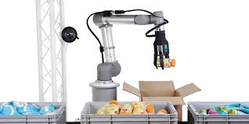
PEAS
Agent: Part-picking robot
Performance measure: Percentage of parts in correct bins
Environment: Conveyor belt with parts, bins
Actuators: Jointed arm and hand
Sensors: Camera, joint angle sensors

Slide 82
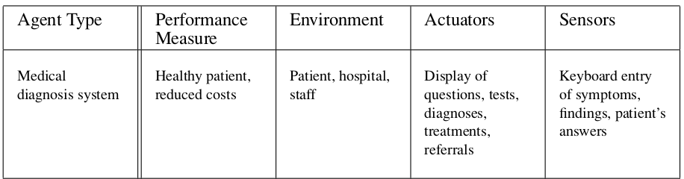
PEAS

Slide 83
Environment types
1. Observable vs Partially observable
In a fully observable environment all of the environment relevant to the action being considered is observable. A chess playing system is an example of a system that operates in a fully observable environment.
In a partially observable environment, the relevant features of the environment are only partially observable. A poker playing program is an example of a system operating in a partially observable environment.

Slide 84
Deterministic/Stochastic/Strategic
In deterministic environments, the next state of the environment is completely described by the current state and the agent’s action. Image analysis systems are examples of this kind of situation. The processed image is determined completely by the current image and the processing operations.
If an element of interference or uncertainty occurs then the environment is stochastic. Examples of this: backgammon game (because it involves throwing a dice)
If the environment state is wholly determined by the preceding state and the actions of multiple agents, then the environment is said to be strategic. Example: Chess. There are two agents, the players and the next state of the board is strategically determined by the players’ actions.

Slide 85
Episodic vs Sequential
Episodic: The agent's experience is divided into atomic "episodes" (each episode
consists of the agent perceiving and then performing a single action), and the choice of action in each episode depends only on the episode itself.
example : many classifiers
mail spam or not?
Sequential: In a sequential environment, the agent engages in a series of connected episodes.

Slide 86
Static vs Dynamic
Static Environment: does not change from one state to the next while the agent is considering its course of action. The only changes to the environment are those caused by the agent itself.
• A static environment does not change while the agent is thinking.
• The passage of time as an agent deliberates is irrelevant.
• The agent doesn’t need to observe the world during deliberation.
A Dynamic Environment changes over time independent of the actions of the agent -- and thus if an agent does not respond in a timely manner, this counts as a choice to do nothing

Slide 87
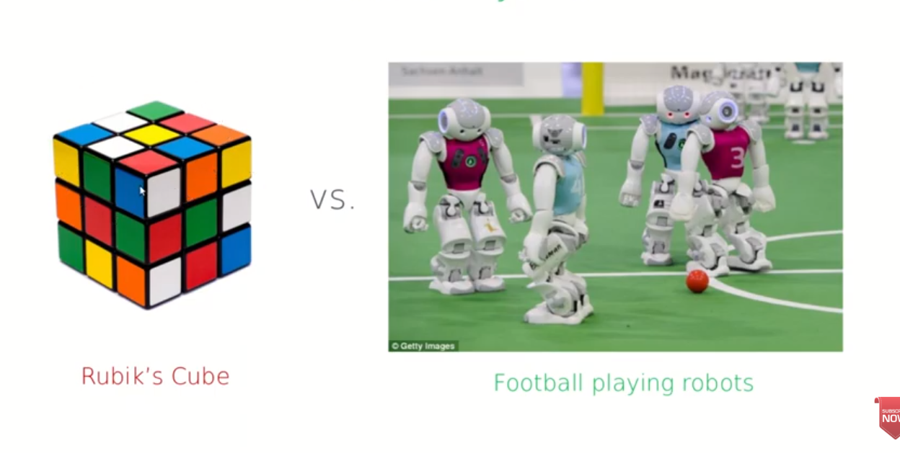
Static vs Dynamic

Slide 88
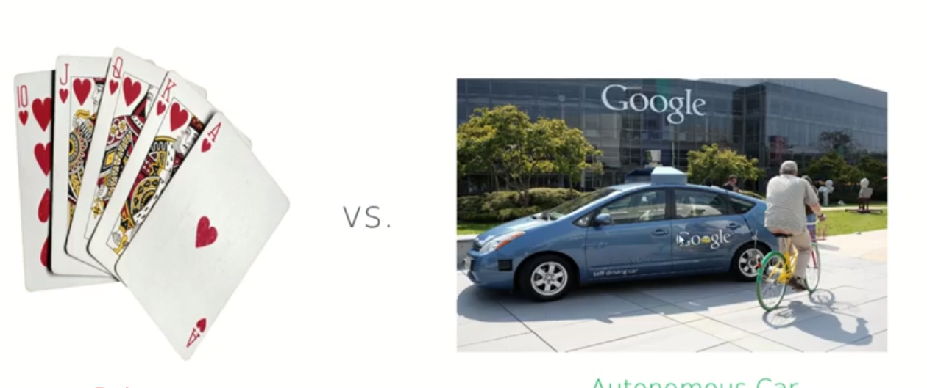
Discrete vs. continuous
Discrete (vs. continuous): A limited number of distinct, clearly defined percepts and actions.

Slide 89
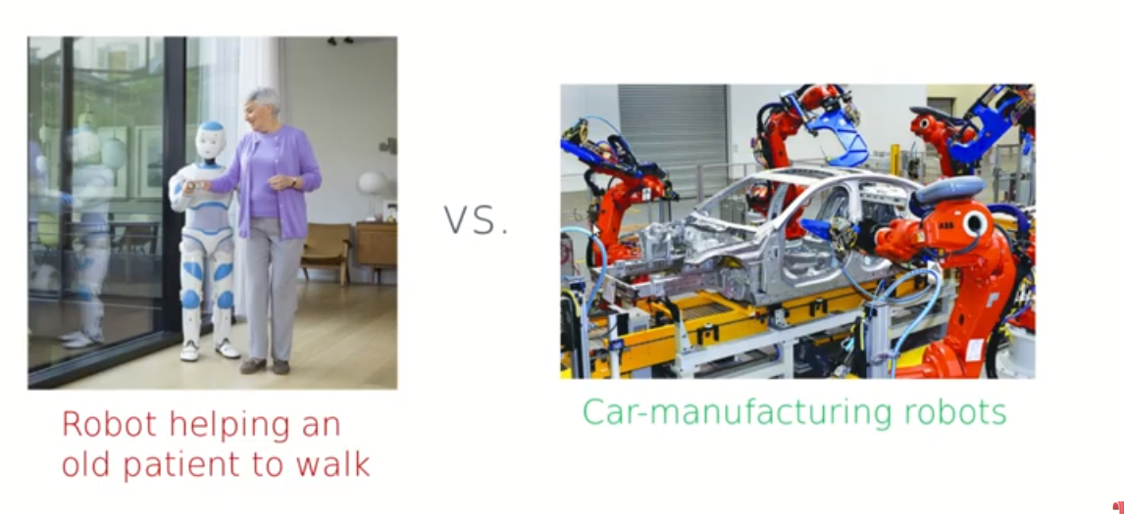
Single agent (vs. multiagent)
Single agent (vs. multiagent): An agent operating by itself in an environment whereas in multiagent we have more than one agent’s actions are important.

Slide 90
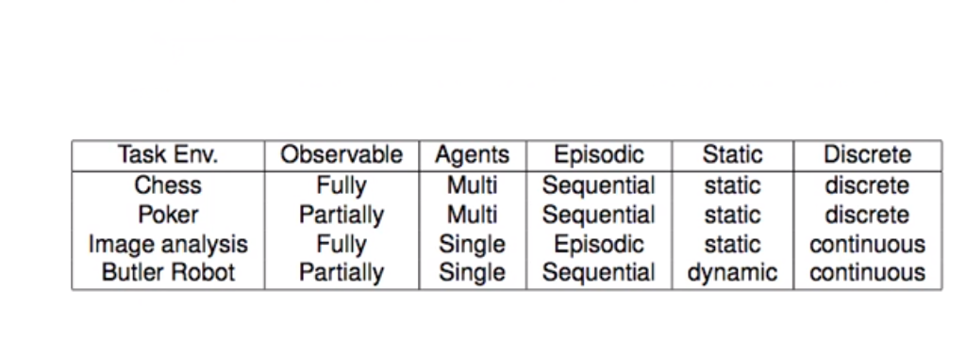
Environment types
The environment type largely determines the agent design
The real world is (of course) partially observable, stochastic, sequential, dynamic, continuous, multi-agent

Slide 91
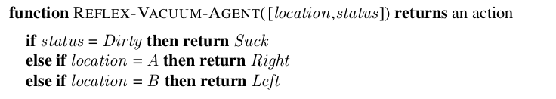
Simple Reflex Agent

Slide 92
Simple Reflex Agents
In reflex based agents,
information comes from sensors - percepts
changes the agents current state of the world
triggers actions through the effectors
Reactive agents have no notion of history. The current state is as the sensors see it right now. The action is based on the current percepts only.
The following are some of the characteristics of percept-based agents.
Efficient
No internal representation for reasoning, inference.
No strategic planning, learning.
Percept-based agents are not good for multiple, opposing, goals.

Slide 93
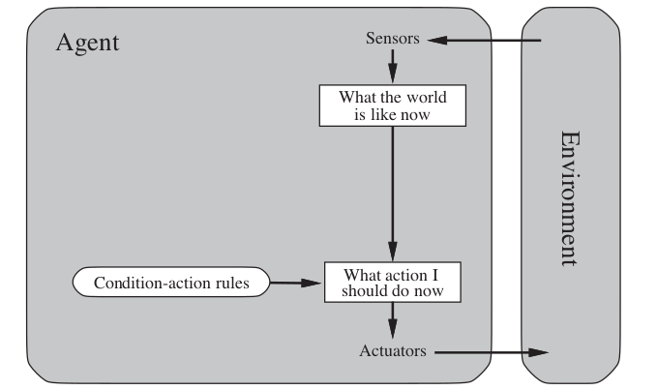
Simple Reflex Agent

Slide 94
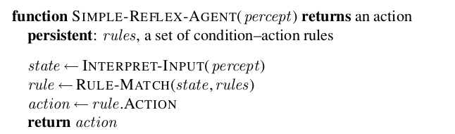
Simple Reflex Agent

Slide 95
Model based Agents
Model based agents differ from percept based agents in that such agents maintain some sort of state based on the percept sequence received so far. The state is updated regularly based on what the agent senses, and the agent’s actions. Keeping track of the state requires that:
the agent has knowledge about how the world evolves, and how the agent’s actions affect the world.
Thus a state based agent works as follows:
information comes from sensors - percepts
based on this, the agent changes the current state of the world
based on state of the world and knowledge (memory), it triggers actions through the effectors

Slide 96
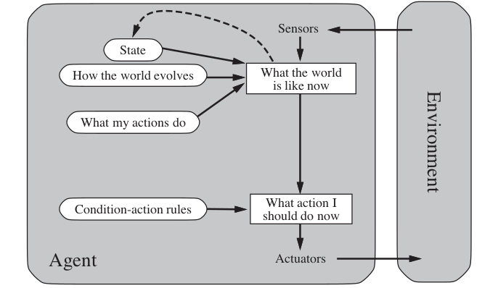
Model Based Agent

Slide 97
Goal based agent
The goal based agent has some goal which forms a basis of its actions. Such agents work as follows:
information comes from sensors - percepts
changes the agents current state of the world
based on state of the world and knowledge (memory) and goals/intentions, it chooses actions and does them through the effectors.
Goal formulation based on the current situation is a way of solving many problems and search is a universal problem solving mechanism in AI.

Slide 98
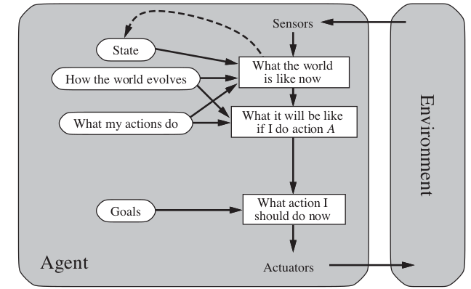
Goal based Agent

Slide 99
Utility based Agent
Utility based agents provides a more general agent framework. In case that the agent has multiple goals, this framework can accommodate different preferences for the different goals. Such systems are characterized by a utility function that maps a state or a sequence of states to a real valued utility.

Slide 100
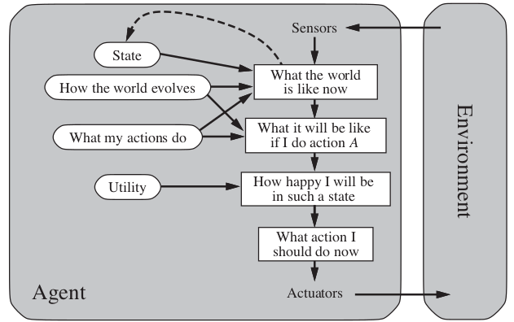
Utility based Agent

Slide 101
Learning Agent
Learning allows an agent to operate in initially unknown environments.
The learning element modifies the performance element.
Learning is required for true autonomy

Slide 102
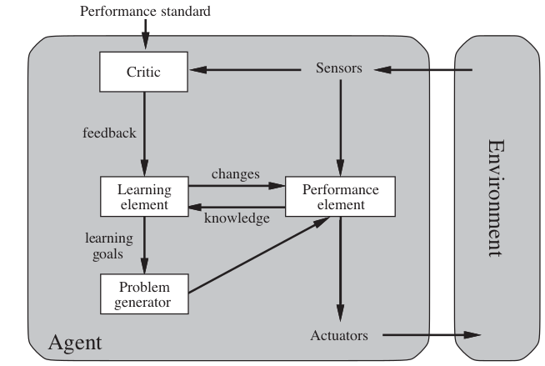
Learning based Agent

Slide 103
Thank You
Required Reading: AIMA - Chapter # 2-
Note : Some of the slides are adopted from AIMA TB materials
103
Notes:
103

Slide 104
Artificial & Computational Intelligence
Session 3: Problem Solving Agent using Uninformed Search

Slide 105
Lecture Outline
Problem Formulation – Examples
Algorithms: BFS, Uniform cost Search, DFS, Depth Limited Search, Iterative Deepening Search, Bidirectional Search
Comparisons of algorithms
Reference: Chapter 3.1-3.4 from AI: A modern approach (Russell, Norvig)

Slide 106
Agent Architecture Recap
Goal based Agent
Problem Solving Agents

Slide 107
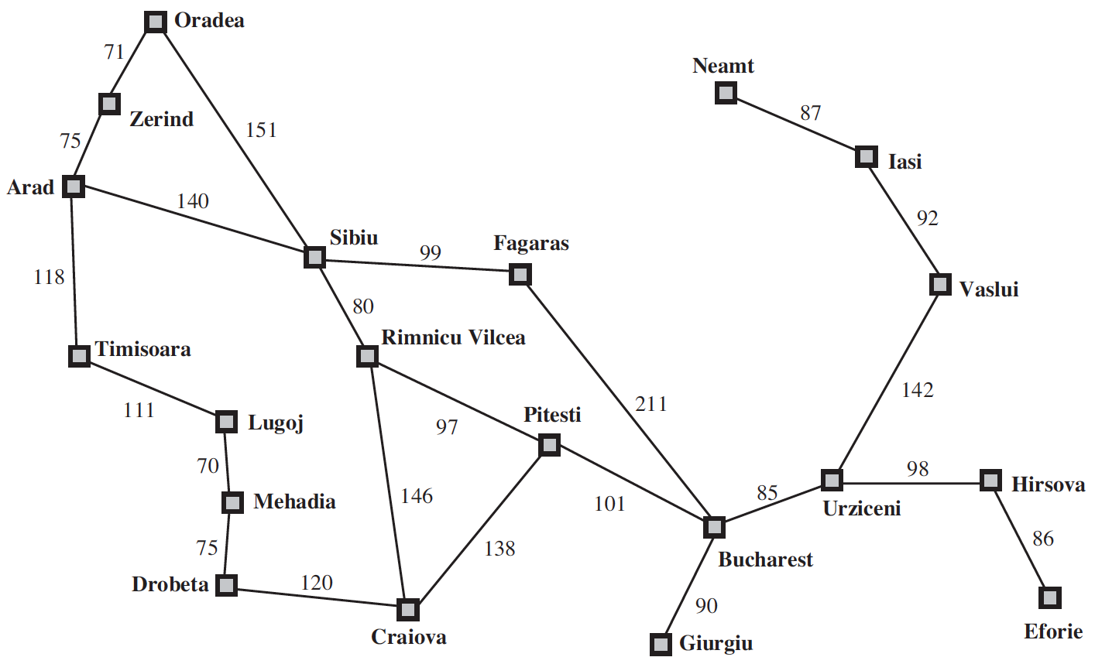
Problem Solving Agents
Agent is here

Slide 108
Problem Solving Agents
Agent is holidaying in Arad.
Many factors in its performance measure
Tour the famous places
Try local cuisine
Souvenir Shopping

Slide 109
Problem Solving Agents
Agent is here
Goal

Slide 110
Problem Solving Agents
Goal Formulation
Optimizes the agent’s objectives
Thereby, limits the actions that can be taken

Slide 111
Problem Solving Agents
In order to reach the Goal – Bucharest
Several States and Actions are possible
Agent can drive to airport or can hire a taxi or take a bus
Agent can take a detour to another city and board a flight to Bucharest
Problem Formulation: Process of deciding what actions and states to consider, given a goal

Slide 112
Problem Solving Agents
Unknowns about the Environment
Doesn’t know what state the agent is in
Estimation of number of possible actions
Doesn’t know the value of actions
Doesn’t know the resulting state of actions
Assumptions about the Environment
Observable: Agent always knows the current state
Discrete: At any given state, only finitely many actions to choose from
Known: Knows which states are reached by each action
Deterministic: Each action would always have the same resulting state

Slide 113
Problem Solving Agents
Under these assumptions, the solution would be
A Fixed Sequence of Actions
Search: The process of looking for a fixed sequence of actions that reaches a goal
Search Algorithm: Takes problem as input and outputs sequence of actions

Slide 114
Problem Solving Agents
Formulate – Define the problem and its components
Search – Solve the problem using search algorithms
Execute – Execute the solution of fixed sequence of actions

Slide 115
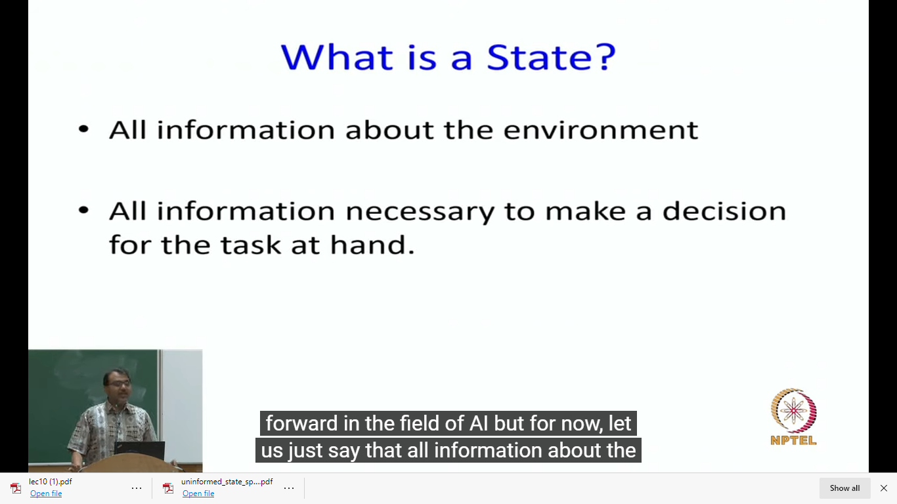
Notion of a state

Slide 116
Problem Solving Agents – Formulate
A problem can be formulated using five components
Initial State – The agent’s starting state. E.g., In(Arad)
Possible Actions – Set of applicable actions in a given state. E.g., from the state s = In(Arad), applicable actions
ACTIONS(s) ➔ {Go(Sibiu), Go(Timisoara), Go(Zerind)}
Transition Model – The resulting state of an action in a given state, modeled as RESULT(s, a)
RESULT( In(Arad), Go(Sibiu) ) = In(Sibiu)
Goal Test – Determines whether a given state is a goal state.
IsGoal( In(Bucharest) ) = Yes
Path Cost – A function that assigns a numeric cost to each path. A path is a series of actions. Each action is given a cost depending on the problem.
cost( In(Arad), go(Sibiu)) = 140 kms

Slide 117
Problem Solving Agents – Formulate
In the above definition
Many possible states – In(Arad), the agent has many possibilities in real world, e.g., can be in the middle of Arad, near an airport, shopping center, hotel, etc.
Many possible actions – Agent can take several actions while driving from Arad to Sibiu. It can halt at a place, take a detour, turn the radio on.
However, they are irrelevant for finding the solution of path to Bucharest
Hence, can be abstracted
Abstraction – Process of removing detail from a representation

Slide 118
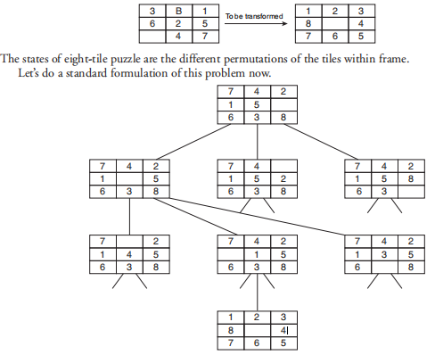
Problem formulation of the Eight Tile Puzzle
The eight tile puzzle consist of a 3 by 3 (3 × 3) square frame board which holds eight movable tiles numbered 1 to 8. One square is empty, allowing the adjacent tiles to be shifted. The objective of the puzzle is to find a sequence of tile movements that leads from a starting configuration to a goal configuration.

Slide 119
Problem formulation of the Eight Tile Puzzle
States: It specifies the location of each of the eight tiles and the blank in one of the nice squares.
Initial state: Any state can be designated as the initial state.
Goal: Many goal configurations are possible.
Legal moves (or state): They generate legal states that result from trying the four actions:
Blank moves left
Blank moves right
Blank moves up
Blank moves down
Path cost: Each step costs 1, so the path cost is the number of steps in the path.

Slide 120

Formulate – Vacuum Cleaner Example
Vacuum World

Slide 121
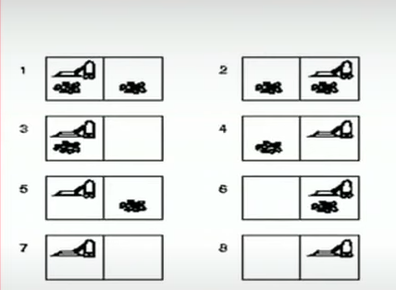
States in Vacuum Cleaner

Slide 122
Formulate – Vacuum cleaner Example
Possible States – There are two locations and two possibilities of dirt. Hence, there would be a total of 8 possible states, i.e., 2x2²
Initial State – Any state with position of agent and dirt mentioned
Actions – Three possible actions, Left, Right, Suck
Transition Model – Left would move the agent to left location, except when the agent is in leftmost location, there would be no effect. Similarly for Right action. Suck would remove the dirt, if any.
Goal Test – Checks whether all locations are clean
Path cost – Each step costs 1, so the path cost is total number of steps

Slide 123
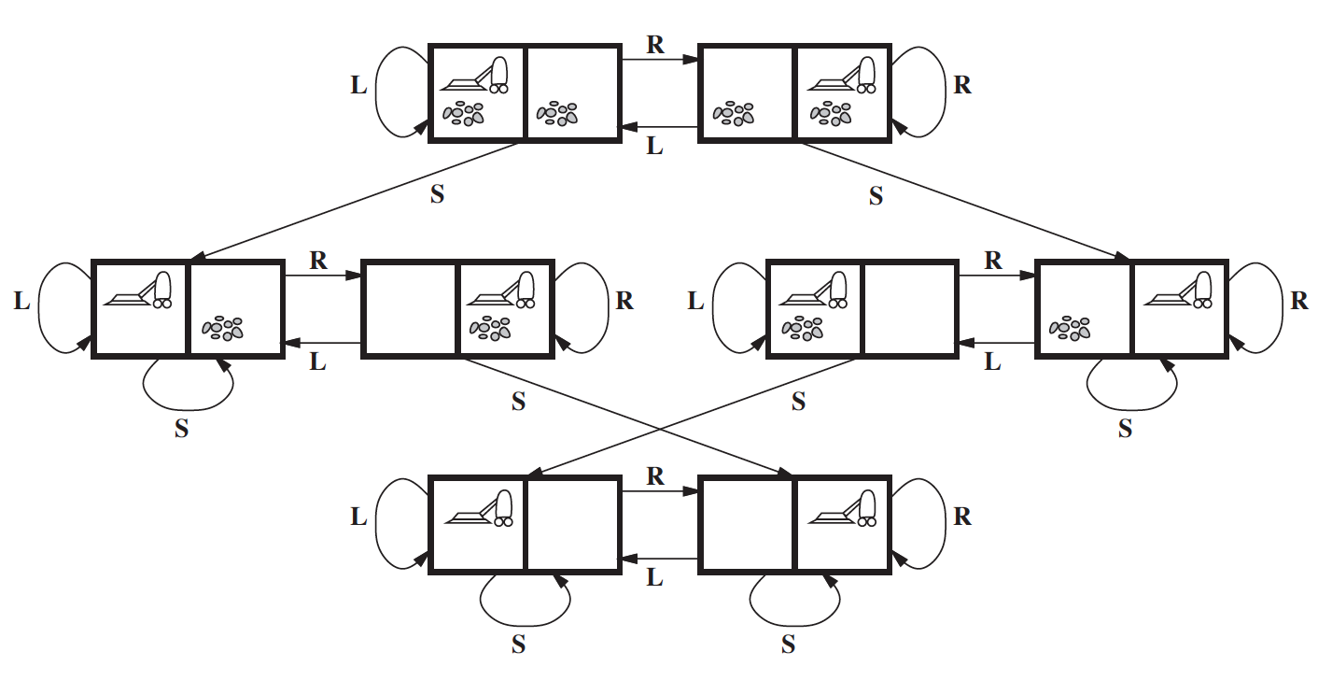
Formulate – Toy Problem Example

Slide 124
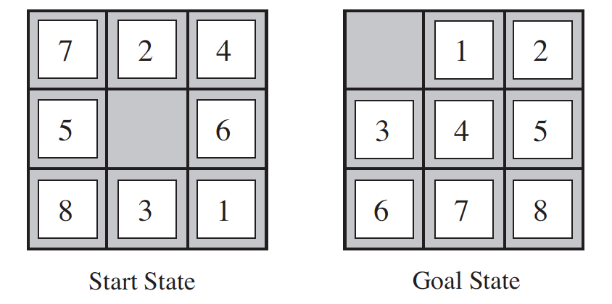
Formulate – Toy Problem Example
8-puzzle

Slide 125
Formulate – Toy Problem Example
Initial State – Any permutation of 1-8 numbers with a blank
Actions – Movement of blank space either by Left, Right, Up or Down
Transition Model – The resulting state after moving the blank space will replace the digit
Goal Test – Check whether the state matches the goal configuration
Path cost – Each step costs 1, so the path cost is total number of steps

Slide 126
Formulate – Real World Example
Airline Travel problem – the task of a travel agent to book cheapest and fastest flight route from City A to City B.
E.g., Need to Travel from Delhi to Los Angeles within Rs. 70,000
Possible States – Each state is a location and current time.
Initial State – Specified by User’s query
Actions – Flight from current location at a particular time with enough time for within-airport transfer if needed
Transition Model – The destination location and arrival time
Goal test – Are we at final destination at the specified time?
Path Cost – Flight cost + Duration + Waiting time + Immigration, etc.

Slide 127
Searching for Solutions
Solution for above Problems: A sequence of possible actions starting at the initial state and reaching the destination specified
Search Algorithms:
Given problem formulation as input, these algorithms would output the sequence of actions
Search Trees - Where states are nodes and actions are edges. The initial state will be the root node and possible actions are branches
In(Arad)
Parent Node
Go(Sibiu)
Go(Timisoara)
Go(Zerind)
In(Sibiu)
In(Timisoara)
In(Zerind)
Child Nodes

Slide 128
Searching for Solutions
In(Arad)
Generation
Go(Sibiu)
Go(Timisoara)
Go(Zerind)
Expansion
In(Sibiu)
In(Timisoara)
In(Zerind)
Search Problem: Which branch to generate next?

Slide 129
Tree Search Algorithm
In(Arad)
Go(Sibiu)
Go(Timisoara)
Go(Zerind)
In(Sibiu)
In(Timisoara)
In(Zerind)
Go(Arad)
Go(Fagaras)
Go(Oradea)
Go(Rimnicu Vilcea)
In(Arad)
In(Fagaras)
In(Oradea)
In(Rimnicu Vilcea)
Tree – Search Algorithm

Slide 130
Tree Search Algorithm
In(Arad)
Go(Sibiu)
Go(Timisoara)
Go(Zerind)
In(Sibiu)
In(Timisoara)
In(Zerind)
Go(Arad)
Go(Fagaras)
Go(Oradea)
Go(Rimnicu Vilcea)
In(Arad)
In(Fagaras)
In(Oradea)
In(Rimnicu Vilcea)
Leaf Nodes
(no children yet)
Frontier: Set of all leaf nodes available for expansion at any given point
Search Strategy: Choosing which state to expand next

Slide 131
Tree Search Algorithm
In(Arad)
Repeated State
generated by
Loopy Path
Go(Sibiu)
Go(Timisoara)
Go(Zerind)
In(Sibiu)
In(Timisoara)
In(Zerind)
Go(Arad)
Go(Fagaras)
Go(Oradea)
Go(Rimnicu Vilcea)
In(Arad)
In(Fagaras)
In(Oradea)
In(Rimnicu Vilcea)
Redundant Path: More than one way to reach a state from another.
E.g., Arad – Sibiu (140 kms) and Arad-Zerind-Oradea-Sibiu (297 kms)
Loopy Path is a special case

Slide 132
Graph Search Algorithm
To solve the Redundancy Path problem,
Explored Set: keeps track of states that are already visited
Augments the Tree-Search algorithm to solve redundancy
We call it Graph-Search Algorithm
Therefore, the search tree contains at most one copy of each state
Growing a tree directly on the state-space graph

Slide 133
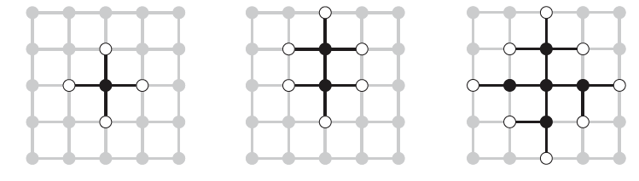
Graph Search Algorithm
Rectangular Grid Problem

Slide 134
Graph Search Algorithm

Slide 135
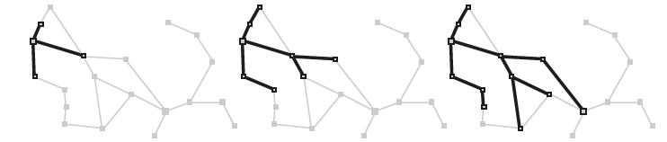
Graph Search Algorithm
Zerind
Arad
Sibiu
Timisoara

Slide 136
Infrastructure for Search Algorithms
For each node n of the tree,
n.STATE: the state in the state space to which node corresponds
n.PARENT: the node in the search tree that generated this node
n.ACTION: the action that was applied to parent to generate the node
n.PATH-COST: the cost, denoted by g(n), of the path from initial state to node
Parent
State = Sibiu
Action = Go(Sibiu)
Path Cost = 300kms
Node

Slide 137
Infrastructure for Search Algorithms
Nodes vs States
Node – a bookkeeping data structure used to represent the search tree
State – configuration of the world
Two different nodes might have same state – if that state is generated from two different paths
Frontier – needs to be stored in a queue with a strategy to help pick the next node for expansion
Strategies can be
FIFO (First In First Out) – Pops the oldest element of the queue
LIFO (Last In First Out) – Pops the newest element of the queue
Priority Queue – pops the element with highest priority

Slide 138
Measuring Search Algorithm Performance
Completeness – Is the algorithm guaranteed to find a solution when there is one?
Optimality – Does the algorithm find the optimal solution?
Time Complexity – How long does it take to find the solution?
Space Complexity – How much memory is needed to perform the search?

Slide 139
Measuring Search Algorithm Performance
Time and space complexity
Search in AI is represented by initial state, actions and transitions which usually result in infinite Nodes and Edges in a graph.
Hence, the complexity is rather measured by
Branching Factor b: Maximum number of successors of any node
Depth d of the shallowest goal, i.e., number of steps from initial node
Maximum length (m) of any path in state space

Slide 140
Measuring Search Algorithm Performance
Effectiveness of an algorithm can be measured by:
Search Cost: Time spent by the algorithm in finding a solution (can also include memory usage)
Solution Cost: Path cost of the solution
Total Cost: Search Cost + Solution Cost (if not in same units, convert them)

Slide 141
Search Algorithms
Uninformed Search Algorithms
No additional information about states beyond what is provided in problem formulation
Generate successors and distinguish a goal state from a non-goal state
Informed Search Algorithms
Strategies that know if one non-goal state is more promising than another non-goal state
Also called Heuristic Search strategies

Slide 142
Uninformed Search Algorithms
Breadth First Search
Uniform Cost Search
Depth First Search
Depth Limited Search
Iterative deepening Depth First Search

Slide 143
Breadth First Search

Slide 144

Breadth First Search (BFS)
Initially fringe is 1. A
2. B C goal node: F
3. C D E
4. D E F G
E F G PATH: A- C-F: COST:1+1:2
F G
Generate all nodes at a given depth before proceeding to deeper nodes

Slide 145
Breadth First Search
All nodes at a given depth are expanded first before any nodes at next level
FIFO queue for Frontier
Shallowest (min depth) unexpanded node is chosen for expansion
Instance of general graph-search algorithm
Discards any redundant path by checking with Explored Set and Frontier Set (must have a path shallower which was seen before)
Hence, it always has the shallowest path to every state

Slide 146

Breadth First Search – Evaluation
Complete – If the shallowest goal node is at a depth d, BFS will eventually find it by generating all shallower nodes
Optimal – Not necessarily. Optimal if path cost is non-decreasing function of depth of node. E.g., all actions have same cost
Time Complexity – $𝒪(b^{d})$ b - branching factor, d – depth
Nodes expanded at depth 1 = b
Nodes expanded at depth 2 = b²
Nodes expanded at depth d = b^{d}
Space Complexity – $𝒪(b^{d})$
$𝒪(b^{d−1})$ in explored set$, 𝒪(b^{d})$ in frontier set.

Slide 147

Breadth First Search – Evaluation
Why is Space Complexity a big problem? Imagine a problem with
branching factor b = 10
generates 1 million nodes/sec
Each node requires 1KB

Slide 148
Depth First Search

Slide 149

DFS EXAMPLE 1

Slide 150

DFS EXAMPLE 2

Slide 151

DFS - Evaluation
Completeness – not Complete in finite state spaces
Optimal – Not Optimal as it would stop when the goal node is reached without evaluating if there is a better path
Time Complexity - $𝒪(b^{m})$ where m = maximum depth of any node
Can be much larger than the size of state space
m can be much larger than d (shallowest goal)
Space Complexity – Needs to store only one path and unexpanded siblings.
Any node expanded with all its children can be removed from memory
Requires storage of only $𝒪\left(bm\right),$ b – branching factor, m - max depth

Slide 152

Depth Limited Search (DLS)
Running DFS with a predetermined depth limit l
Completeness: No, cannot guarantee a goal if l < d
Optimal: No
Time complexity: $𝒪(b^{l})$
Space Complexity: $𝒪\left(bl\right)$

Slide 153
Iterative Deepening Depth First Search (IDS

Slide 154

Iterative Deepening Depth First Search (IDS)
Run Depth Limited Search (DLS) by gradually increasing the limit l
First with l=1, then l=2, l=3 and so on – until goal is found
Its is a combination of Depth First Search + Breadth First Search
Like DFS, memory requirement is a modest $𝒪\left(bd\right)$ where d is the depth of shallowest goal
Reason: DLS with l=1; space requirement is b
DLS with l=2. space requirement is b+b=2b
DLS with l=d, space requirement is b*d=bd
Like BFS
Complete when branching factor is finite
Guarantee for goal node of minimum depth

Slide 155

Iterative Deepening Depth First Search (IDS)
Time Complexity:
Appears that IDS is generating a lot of nodes multiple times
However, most of nodes are present in the lower levels which are not repeated often
Generation of nodes
At level 1 - b nodes generated d times – (d)b
At level 2 – b² nodes generated d-1 times – (d-1)b²
At level d – b^{d} nodes generated once – (1) b^{d}
Time Complexity N(IDS) = $𝒪(b^{d})$ slightly more than BFS or DFS
IDS is the preferred uninformed search method when search space is large and depth is unknown

Slide 156

IDS

Slide 157
Uniform Cost Search
This algorithm is by Dijkstra [1959]. The algorithm expands nodes in the order of their cost from the source.
In uniform cost search the newly generated nodes are put in OPEN according to their path costs. This ensures that when a node is selected for expansion it is a node with the cheapest cost among the nodes in OPEN.
Let g(n) = cost of the path from the start node to the current node n. Sort nodes by increasing value of g.

Slide 158
Uniform Cost Search
Instead of expanding the shallowest node, Uniform-Cost search expands the node n with the lowest path cost g(n)
Sorting the Frontier as a priority queue ordered by g(n)
Goal test is applied during expansion
The goal node if generated may not be on the optimal path
Find a better path to a node on the Frontier

Slide 159

Uniform Cost Search
Current State: Sibiu
Frontier: []
Step: Expand Sibiu
Result: Generates (“Rimnicu Vilcea” 80)
(“Fagaras”, 99)
Add to Frontier
Initial State: Sibiu
Goal State: Bucharest

Slide 160
Uniform Cost Search
Current State: Sibiu
Frontier: [(“Rimnicu Vilcea” 80)
(“Fagaras”, 99)]
Step: Expand “Rimnicu Vilcea” (least cost)
Result: Generates (“Pitesti”, 177)
Add to Frontier
Initial State: Sibiu
Goal State: Bucharest

Slide 161
Uniform Cost Search
Current State: Rimnicu Vilcea (not a Goal state)
Frontier: [ (“Fagaras”, 99)
(“Pitesti”, 177)]
Step: Expand “Fagaras” (least cost)
Result: Generates (“Bucharest”, 310)
Add to Frontier
(It’s a Goal State but we won’t
test during generation)
Initial State: Sibiu
Goal State: Bucharest

Slide 162
Uniform Cost Search
Current State: Fagaras (not a goal state)
Frontier: [ (“Pitesti”, 177)
(“Bucharest”, 310)]
Step: Expand “Pitesti” (least cost)
Result: Generates (“Bucharest”, 278)
Replace in Frontier
(It’s a Goal State but we won’t
test during generation)
Initial State: Sibiu
Goal State: Bucharest

Slide 163
Uniform Cost Search
Current State: Pitesti (not a goal state)
Frontier: [ (“Bucharest”, 278)]
Step: Expand “Bucharest”
Result: No further generation
as Goal Test satisfied
Return Solution
Initial State: Sibiu
Goal State: Bucharest

Slide 164

Uniform Cost Search – Evaluation
Completeness – It is complete if the cost of every step > small +ve constant $∈$
It will stuck in infinite loop if there is a path with infinite sequence of zero cost actions
Optimal – It is Optimal. Whenever it selects a node, it is an optimal path to that node.
Time and Space complexity – Uniform cost search is guided by path costs not depth or branching factor.
If C* is the cost of optimal solution and $∈$ is the min. action cost
Worst case complexity = $𝒪(b^{1+\frac{C^{∗}}{∈}})$ ,
When all action costs are equal → $𝒪(b^{d+1})$, the BFS would perform better
As Goal test is applied during expansion, Uniform Cost search would do extra work

Slide 165
ACI Session 4: Uninfomed Search Revisited: DFS,BFS,DLS,IDS. UCS, bidirectional search Informed Search: Best First

Slide 166
Search Algorithms
Breadth First Search
Uniform Cost Search
Depth First Search
Depth Limited Search
Iterative deepening Depth First Search
Informed Search
Best First greedy Search

Slide 167
Breadth First Search

Slide 168
Breadth First Search (BFS)
Initially fringe is 1. A
2. B C goal node: F
3. C D E
4. D E F G
E F G PATH: A- C-F: COST:1+1:2
F G
Generate all nodes at a given depth before proceeding to deeper nodes

Slide 169
Breadth First Search
All nodes at a given depth are expanded first before any nodes at next level
FIFO queue for Frontier
Shallowest (min depth) unexpanded node is chosen for expansion
Instance of general graph-search algorithm
Discards any redundant path by checking with Explored Set and Frontier Set (must have a path shallower which was seen before)
Hence, it always has the shallowest path to every state

Slide 170
Breadth First Search – Evaluation
Complete – If the shallowest goal node is at a depth d, BFS will eventually find it by generating all shallower nodes
Optimal – Not necessarily. Optimal if path cost is non-decreasing function of depth of node. E.g., all actions have same cost
Time Complexity – $𝒪(b^{d})$ b - branching factor, d – depth
Nodes expanded at depth 1 = b
Nodes expanded at depth 2 = b²
Nodes expanded at depth d = b^{d}
Space Complexity – $𝒪(b^{d})$
$𝒪(b^{d−1})$ in explored set$, 𝒪(b^{d})$ in frontier set.

Slide 171
Breadth First Search – Evaluation
Why is Space Complexity a big problem? Imagine a problem with
branching factor b = 10
generates 1 million nodes/sec
Each node requires 1KB

Slide 172
Depth First Search

Slide 173
DFS

Slide 174
DFS - Evaluation
Completeness – not Complete in finite state spaces
Optimal – Not Optimal as it would stop when the goal node is reached without evaluating if there is a better path
Time Complexity - $𝒪(b^{m})$ where m = maximum depth of any node
Can be much larger than the size of state space
m can be much larger than d (shallowest goal)
Space Complexity – Needs to store only one path and unexpanded siblings.
Any node expanded with all its children can be removed from memory
Requires storage of only $𝒪\left(bm\right),$ b – branching factor, m - max depth

Slide 175
Depth Limited Search (DLS)
Running DFS with a predetermined depth limit l
Completeness: No, cannot guarantee a goal if l < d
Optimal: No
Time complexity: $𝒪(b^{l})$
Space Complexity: $𝒪\left(bl\right)$

Slide 176
Iterative Deepening Depth First Search (IDS

Slide 177
Iterative Deepening Depth First Search (IDS)
Run Depth Limited Search (DLS) by gradually increasing the limit l
First with l=1, then l=2, l=3 and so on – until goal is found
Its is a combination of Depth First Search + Breadth First Search
Like DFS, memory requirement is a modest $𝒪\left(bd\right)$ where d is the depth of shallowest goal
Reason: DLS with l=1; space requirement is b
DLS with l=2. space requirement is b+b=2b
DLS with l=d, space requirement is b*d=bd
Like BFS
Complete when branching factor is finite
Guarantee for goal node of minimum depth

Slide 178
Iterative Deepening Depth First Search (IDS)
Time Complexity:
Appears that IDS is generating a lot of nodes multiple times
However, most of nodes are present in the lower levels which are not repeated often
Generation of nodes
At level 1 - b nodes generated d times – (d)b
At level 2 – b² nodes generated d-1 times – (d-1)b²
At level d – b^{d} nodes generated once – (1) b^{d}
Time Complexity N(IDS) = $𝒪(b^{d})$ slightly more than BFS or DFS
IDS is the preferred uninformed search method when search space is large and depth is unknown

Slide 179
IDS

Slide 180
Bidirectional Search
Two different searches are run simultaneously
From start to goal
From goal to start
Usually BFS technique is used
Advantages:
Fast
Less memory
Disadvantage:
Implementation is difficult
The search stops when two graphs intersect each other

Slide 181
Example: Bidirectional Search

Slide 182
Uniform Cost Search
This algorithm is by Dijkstra [1959]. The algorithm expands nodes in the order of their cost from the source.
In uniform cost search the newly generated nodes are put in OPEN according to their path costs. This ensures that when a node is selected for expansion it is a node with the cheapest cost among the nodes in OPEN.
Let g(n) = cost of the path from the start node to the current node n. Sort nodes by increasing value of g.

Slide 183
Uniform Cost Search
Instead of expanding the shallowest node, Uniform-Cost search expands the node n with the lowest path cost g(n)
Sorting the Frontier as a priority queue ordered by g(n)
Goal test is applied during expansion
The goal node if generated may not be on the optimal path
Find a better path to a node on the Frontier

Slide 184

Uniform Cost Search

Slide 185
Uniform Cost Search – Evaluation
Completeness – It is complete if the cost of every step > small +ve constant $∈$
It will stuck in infinite loop if there is a path with infinite sequence of zero cost actions
Optimal – It is Optimal. Whenever it selects a node, it is an optimal path to that node.
Time and Space complexity – Uniform cost search is guided by path costs not depth or branching factor.
If C* is the cost of optimal solution and $∈$ is the min. action cost
Worst case complexity = $𝒪(b^{1+\frac{C^{∗}}{∈}})$ ,
When all action costs are equal → $𝒪(b^{d+1})$, the BFS would perform better
As Goal test is applied during expansion, Uniform Cost search would do extra work

Slide 186

Summary

Slide 187

Comparison

Slide 188

Search on undirected graph or directed graph with cycles

Slide 189

Graph Search: Handling repeated nodes

Slide 190
Disadvantage of Uninformed Search(Blind Search
Uninformed Search is slow
Solution: Add guidance (heuristic estimate)
Informed Search

Slide 191

Informed Search
Idea: Be smart about what paths to try

Slide 192
Difference between Blind and informed Search
In uninformed search we only have problem at hand.
But in the informed search, node is selected for expansion based on an evaluation function that estimates cost to the goal.
Use problem specific knowledge beyond the definition of problem to
guide the search
Helps to cut the search space & thereby improves efficiency

Slide 193

General Tree Search paradigm

Slide 194
Informed Search Algorithm
The evaluation function f(n) typically includes a heuristic function h(n)
h(n): Estimated cost of the cheapest path from the state at node n to a goal state
Used to include common form of additional knowledge to search algorithms
h(n) is non-negative
h(n) = 0 when n is goal node
brings in problem specific knowledge to solving search problem.

Slide 195

Best First Search f(n)=h(n)

Slide 196

Example

Slide 197


Slide 198


BITS Pilani
Pilani Campus
Session 5: Informed Search (A*) And its proof of optimiality

Slide 199
Session Content
Informed Search (A*)
Admissibility of heuristic
Optimality of A*
BITS Pilani, Pilani Campus

Slide 200

A* Search
BITS Pilani, Pilani Campus

Slide 201

A* Search

Slide 202


A* Search

Slide 203

A* Search

Slide 204

A* Search

Slide 205

A* Search

Slide 206

A* Search

Slide 207

Admissible Heuristics
BITS Pilani, Pilani Campus

Slide 208

Example
BITS Pilani, Pilani Campus

Slide 209

Consistent Heuristic
BITS Pilani, Pilani Campus

Slide 210

Proof of Optimality of A*
BITS Pilani, Pilani Campus

Slide 211

Proof of Optimality of A*
BITS Pilani, Pilani Campus

Slide 212

Admissible Heuristics
BITS Pilani, Pilani Campus

Slide 213

Admissible Heuristics
BITS Pilani, Pilani Campus

Slide 214

Dominance
BITS Pilani, Pilani Campus

Slide 215
Contents: Admissible Heuristics
Relaxed Problems
Memory Bounded A*

Slide 216

A* Analysis

Slide 217
8 Puzzle Problem

Slide 218
Relaxed Problems

Slide 219

Problem Relaxation

Slide 220

Relaxed Problem

Slide 221

Admissible Heuristics

Slide 222
Effective branching factor b*

Slide 223
Effective branching factor b*

Slide 224
Effective branching factor b*

Slide 225

Consistent heuristic

Slide 226

A* difficulties

Slide 227

IDA*

Slide 228


IDA*

Slide 229

IDA* Analysis

Slide 230

IDA* Analysis

Slide 231

IDA* Analysis

Slide 232

Example

Slide 233



Slide 234



Slide 235



Slide 236



Slide 237



Slide 238



Slide 239



Slide 240



Slide 241


Slide 242

RBFS(Recursive Best First Search)

Slide 243

RBFS: Example

Slide 244

Step 1

Slide 245

Step 2

Slide 246

Step 3

Slide 247

Step 4

Slide 248

Step 5: Goal found!

Slide 249

Example 2: RBFS

Slide 250
Thank You

Slide 251
BITS Pilani
Pilani Campus
Contents:RBFS Analysis and SMA* Local Search

Slide 252
Analysis of RBFS
Optimal if h(n) is admissible. Space is O(bm)
Potentially exponential time in cost of solution
Keeps more information than IDA*, but may benefit from storing even more information
BITS Pilani, Pilani Campus

Slide 253

SMA* (Simplified Memory A*)
Š
BITS Pilani, Pilani Campus

Slide 254
SMA*
Expand deepest lowest f-cost leaf-node
Best first search on f-cost
Update f-cost of nodes whose successors F(node)=min(f(child1), f(child2),…..f(childn))
Drop shallowest & highest f-cost leaf node
Remember best forgotten descendant
have higher f-cost than it as:
Node at the maximum depth get ∞ cost if its not a goal node.
BITS Pilani, Pilani Campus

Slide 255

SMA*
BITS Pilani, Pilani Campus

Slide 256
Analysis of SMA*
Optimal if solution fits in memory. Constant memory requirements
BITS Pilani, Pilani Campus

Slide 257

Thank You
BITS Pilani, Pilani Campus

Slide 258

BITS Pilani, Pilani Campus

Slide 259

BITS Pilani, Pilani Campus

Slide 260

BITS Pilani, Pilani Campus

Slide 261

BITS Pilani, Pilani Campus

Slide 262

BITS Pilani, Pilani Campus

Slide 263

BITS Pilani, Pilani Campus

Slide 264

BITS Pilani, Pilani Campus

Slide 265

BITS Pilani, Pilani Campus

Slide 266

BITS Pilani, Pilani Campus

Slide 267

BITS Pilani, Pilani Campus

Slide 268

BITS Pilani, Pilani Campus

Slide 269

BITS Pilani, Pilani Campus

Slide 270

BITS Pilani, Pilani Campus

Slide 271

BITS Pilani, Pilani Campus

Slide 272

BITS Pilani, Pilani Campus

Slide 273

BITS Pilani, Pilani Campus

Slide 274

BITS Pilani, Pilani Campus

Slide 275
BITS Pilani, Pilani Campus

Slide 276

BITS Pilani, Pilani Campus

Slide 277
BITS Pilani
Pilani Campus
ACI: 17TH OCT

Slide 278


Optimization
Let y = x²⁻4x, at what value of x does y will be maximum. a. 2 b. 4 c. 6 d. 8
2

Slide 279

Thank You

Slide 282


Slide 283
Convert N queen problem to optimization problem
It can be treated as maximizing problem. In that case you just maximize the number of non attacking pairs of queens.
Or
It can be treated as minimizing problem. For this case you just minimize the number of attacking pair of queens.

Slide 287

“Landscape” of search
Hill Climbing gets stuck in local maximum
Local maxima: a local maximum, as opposed to a global maximum, is a peak that is lower than the highest peak in the state space.
Plateaux: a plateau is an area of the state space where the evaluation function is essentially flat. The search will conduct a random walk.
Ridges: a ridge may have steeply sloping sides, so that the search reaches the top of the ridge with ease, but the top may slope only very gently toward a peak. Unless there happen to be operators that move directly along the top of the ridge, the search may oscillate from side to side, making little progress.

Slide 288


Slide 289


Slide 291


Slide 293


Slide 294


Slide 295


Slide 296


Slide 297
Simulated Annealing
Observations:
If bad neighbor then ΔE<0
If very bad neighbor, then ΔE will approach towards large negative number Then exp(ΔE/T) will approach towards 0.
It means the probability of accepting bad neighbor is 0.
As time advances Temperature T reduces to small value. Eventually T will tend to 0. In that case exp(ΔE/T) will approach 0. That means, when t is very large and T=0, then probability of accepting the bad neighbor becomes less. So as time passes algorithm is less likely to accept bad moves

Slide 298


Slide 299


Slide 300


Slide 301


Slide 302

Genetic Algorithms
Population of individuals or alternative
(feasible) solutions
Next generation
of individuals
Evaluate individuals
on their fitness
Select individuals based on fitness
for subsequent mating
Arbitrarily change some characteristic
Select individuals & exchange charac- teristics to create new individuals
Heredity
Mating pool of “fitter” individuals

Slide 303
Genetic Algorithms
Basic Tasks
Generation of initial population
Evaluation
Selection (Reproduction operation)
Exchange characteristics to develop new
individuals (Crossover operation)
Arbitrarily modify characteristics in new individuals (Mutation operation)

Slide 304
Genetic Algorithms
What is an individual?
z
x,y,z
24,2,11
1001,0000,1101
y
x
 |  |  | i
 |  |  |  | h
 |  |  | g
 | d | e |  | f
 | b | c
i
h
g
(a,b)(b,c)(c,d)…(h,i)
a,b,c,d,…i
d
e
f
a
a _{b}
c
10/24/2020 12:38 AM

Slide 305
Genetic Algorithms
Basic Tasks
Generation of initial population
Evaluation
Selection (Reproduction operation)
Exchange characteristics to develop new
individuals (Crossover operation)
Arbitrarily modify characteristics in new individuals (Mutation operation)
10/24/2020 12:38 AM

Slide 306
GA operators: Selection
Main idea: better individuals get higher chance
Chances proportional to fitness
Implementation: roulette wheel technique
Assign to each individual a part of the roulette wheel
Spin the wheel n times to select n individuals
1/6 = 17%
A
3/6 = 50%
B
C
fitness(A) = 3
fitness(B) = 1
fitness(C) = 2
2/6 = 33%
10/24/2020 12:38 AM

Slide 307

Can we solve n-queen using Genetic Algo?

Slide 308




Slide 309
Genetic Algorithms
Issues
Representation
Generation of initial population
Evaluation
Reproduction operation
Crossover and Mutation operations and feasibility issues
33

Slide 310
Some Applications
Decision making / decision support systems
Engineering component / equipment design
Engineering process optimization Portfolio optimization
Route optimization; optimal layout; optimal packing
Schedule optimization
Protein structure analysis
10/24/2020 12:38 AM
34

